Slide 1
Pigeonhole Principle
If more pigeons
than pigeonholes,

Slide 2
Pigeonhole Principle
then some hole must have at least two pigeons!
Pigeonhole principle
A function from a larger set to a smaller set cannot be injective.
(There must be at least two elements in the domain that have
the same image in the codomain.)

Slide 3
Example 1
Question: Let A = {1,2,3,4,5,6,7,8}
If five integers are selected from A,
must a pair of integers have a sum of 9?
Consider the pairs {1,8}, {2,7}, {3,6}, {4,5}.
The sum of each pair is equal to 9.
If we choose 5 numbers from this set,
then by the pigeonhole principle,
both elements of some pair will be chosen,
and their sum is equal to 9.

Slide 4
Example 2
Question: In a party of n people, is it always true that there are
two people shaking hands with the same number of people?
Everyone can shake hand with 0 to n-1 people, and there are n people,
and so it does not seem that it must be the case, but think about it carefully:
Case 1: if there is a person who does not shake hand with others,
then any person can shake hands with at most n-2 people,
and so everyone shakes hand with 0 to n-2 people, and so
the answer is “yes” by the pigeonhole principle.
Case 2: if everyone shakes hand with at least one person, then
any person shakes hand with 1 to n-1 people, and so
the answer is “yes” by the pigeonhole principle.
If there are N people and N-1 possibilities to the number of people each person can shake hands with then by Pigeon Hole principle at least 2 people have shook hands with an equal amount of people

Slide 5
Birthday Paradox
In a group of 366 people, there must be two people having the same birthday.
Suppose n <= 365, what is the probability that in a random set of n people,
some pair of them will have the same birthday?
We can think of it as picking n random numbers from 1 to 365 without repetition.
There are 365^{n} ways of picking n numbers from 1 to 365.
There are 365·364·363·…·(365-n+1) ways of
picking n numbers from 1 to 365 without repetition.
So the probability that no pairs have the same birthday is
equal to 365·364·363·…·(365-n+1) / 365^{n}
This is smaller than 50% for 23 people, smaller than 1% for 57 people.

Slide 6
Generalized Pigeonhole Principle
Generalized Pigeonhole Principle
If n pigeons and h holes,
then some hole has at least
pigeons.
♠ ♥ ♣ ♦
Cannot have < 3 cards in every hole.

Slide 7
Subset Sum
Two different subsets of the 90 25-digit numbers shown above have the same sum.

Slide 8
Subset Sum
Let A be the set of the 90 numbers, each with at most 25 digits.
So the total sum of the 90 numbers is at most 90x10²⁵.
Let 2^{A} be the set of all subsets of the 90 numbers.
(pigeons)
Let B be the set of integers from 0 to 90x10²⁵.
(pigeonholes)
Let f:2^{A}->B be a function mapping each subset of A into its sum.
If we could show that |2^{A}| > |B|, then by the pigeonhole principle,
the function f must map two elements in 2^{A} into the same element in B.
This means that there are two subsets with the same sum.

Slide 9

Subset Sum
90 numbers, each with at most 25 digits.
So the total sum of the 90 numbers is at most 90x10²⁵
Let 2^{A} be the set of all subsets of the 90 numbers.
(pigeons)
Let B be the set of integers from 0 to 90x10²⁵.
(pigeonholes)
So, |2^{A}| > |B|.
By the pigeonhole principle, there are two different subsets with the same sum.

Slide 10
Club vs Strangers
Let’s agree that given any two people, either they have met or not.
If every people in a group has met, then we’ll call the group a club.
If every people in a group has not met, then we’ll call a group of strangers.
Theorem: Every collection of 6 people includes a club of 3 people,
or a group of 3 strangers.
Let x be one of the six people.
By the (generalized) pigeonhole principle, we have the following claim.
Claim: Among the remaining 5 people, either 3 of them have met x,
or 3 of them have not met x.

Slide 11
Club vs Strangers
Theorem: Every collection of 6 people includes a club of 3 people,
or a group of 3 strangers.
Claim: Among the remaining 5 people, either 3 of them have met x,
or 3 of them have not met x.
Case 1: “3 people have met x”
Case 1.1: No pair among those people met each other.
Then there is a group of 3 strangers.
OK!
Case 1.2: Some pair among those people have met each other.
Then that pair, together with x, form a club of 3 people.
OK!

Slide 12
Club vs Strangers
Theorem: Every collection of 6 people includes a club of 3 people,
or a group of 3 strangers.
Claim: Among the remaining 5 people, either 3 of them have met x,
or 3 of them have not met x.
Case 2: “3 people have not met x”
Case 2.1: Every pair among those people met each other.
Then there is a club of 3 people.
OK!
OK!
Case 2.2: Some pair among those people have not met each other.
Then that pair, together with x, form a group of 3 strangers.

Slide 13
Club vs Strangers
Theorem: Every collection of 6 people includes a club of 3 people,
or a group of 3 strangers.
Theorem: For every k, if there are enough people,
then either there exists a club of k people,
or a group of k strangers.
A large enough structure cannot be totally disorder.

Slide 14
More applications 1
For every integer n there is a multiple of n that has only 0s and 1s in its decimal representation.
Consider n different numbers $1, 11, 111, …$ Note that the last number has n 1s in its decimal representation. These are the pigeons.
If either of these numbers is a multiple of n we are done. So assume otherwise
Consider the remainder obtained when these numbers are divided by n.
This can take values from 1 to n-1. These are the holes.
Two of the n numbers will have the same remainder when divided by n. Hence the difference of these numbers (which contains only 0s and 1s) is a multiple of n

Slide 15
More applications 2
Team DD plays 45 games in April and at least one game each day. Show that there must be a period of consecutive days during which DD plays exactly 14 games.
$a_{j}$ is the number of games played till day $j$. Note $1≤a_{1}<a_{2}<…<a_{30}=45$
Let $b_{j}=a_{j}+14$. Then $15≤b_{1}<b_{2}<…<b_{30}=59$
Consider the 60 numbers $a_{j}$ and $b_{j}$ as pigeons. Since these numbers take values between 1 and 59, two of them have the same value.
$a_{i}$s and $b_{i}$s are distinct. So it can only be that for some $i,j, a_{i}=b_{j}=a_{j}+14.$
Hence from day j+1 to day i the team played 14 games.

Slide 16
More applications 3
Among n+1 positive integers not exceeding 2n there must be an integer that divides one of the other integers.
Let $1≤a_{1}<a_{2}<…<a_{n+1}≤2n$ be the $n+1$ integers. No loss of generality to assume they are distinct as else the stmt is trivially true.
Let $b_{i}=a_{i}/2^{k_{i}}$ be odd. Then $1≤b_{1},b_{2},…, b_{n+1}≤2n−1$ are $n+1$ odd integers.
Since there are only $n$ odd integers between 1 and $2n−1$, by PHP for some $i,j, b_{i}=b_{j}$.
Let $a_{i}<a_{j}$. Then $k_{i}<k_{j}$ and so $a_{i}=b_{i}2^{k_{i}}$ divides $a_{j}=b_{j}2^{k_{j}}$

Slide 17
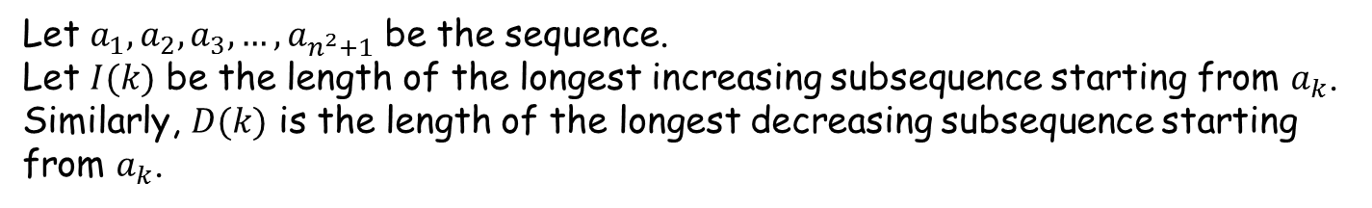
More applications 4
Every sequence of $n^{2}+1$ distinct numbers contains a subsequence of length n+1 that is strictly increasing or strictly decreasing
e.g. 8, 11, 9, 1, 4, 6, 12, 10, 5, 7 contains the increasing subsequence 1,4,6,10 of length 4.
Let $a_{1},a_{2},a_{3}, …{,a}_{n^{2}+1}$ be the sequence.
Let $I(k)$ be the length of the longest increasing subsequence starting from $a_{k}$. Similarly, $D(k)$ is the length of the longest decreasing subsequence starting from $a_{k}$.
In the above example: $I(3)=2, D(3)=3, I(5)=3, D(5)=1$

Slide 18
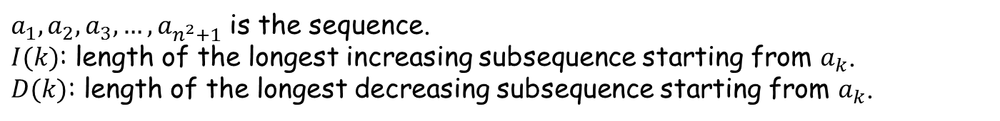
More applications 4 (contd.)
$a_{1},a_{2},a_{3}, …{,a}_{n^{2}+1}$ is the sequence.
$I(k)$: length of the longest increasing subsequence starting from $a_{k}$.
$D(k)$: length of the longest decreasing subsequence starting from $a_{k}$.
If for some $k$, $I(k)$ or $D(k)$ exceeds $n$ then we are done (there is an inc./dec. subsequence of length $n+1$).
For contradiction, assume $∀k, 1≤I\left(k\right),D\left(k\right)≤n$.
Consider the $n^{2}+1$ tuples $\left(I\left(1\right),D\left(1\right)\right), \left(I\left(2\right), D\left(2\right)\right),…,\left(I\left(n^{2}+1\right),D\left(n^{2}+1\right)\right).$ Since these takes $n^{2}$ different values, by PHP $∃r,s:\left(I\left(r\right),D\left(r\right)\right)=\left(I\left(s\right),D\left(s\right)\right)$.
No loss of generality to assume that $r<s$.

Slide 19
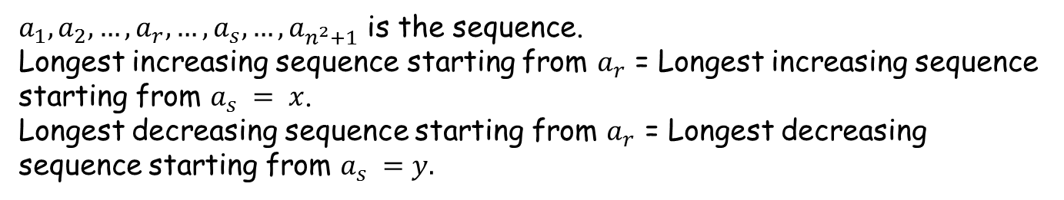
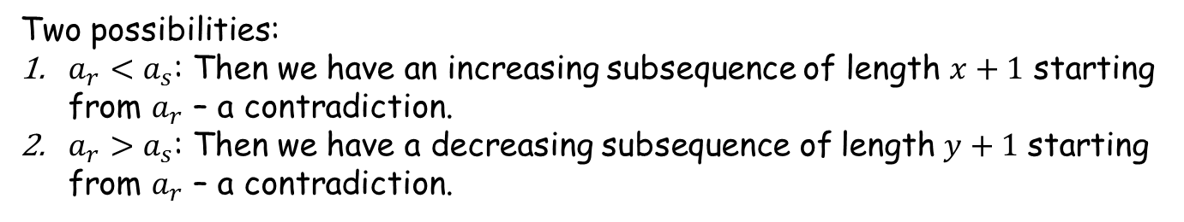
More applications 4 (contd.)
$a_{1},a_{2},…, a_{r},…,a_{s},…, a_{n^{2}+1}$ is the sequence.
Longest increasing sequence starting from $a_{r}$ = Longest increasing sequence starting from $a_{s} = x$.
Longest decreasing sequence starting from $a_{r}$ = Longest decreasing sequence starting from $a_{s} =y.$
Two possibilities:
$a_{r}<a_{s}$: Then we have an increasing subsequence of length $x+1$ starting from $a_{r}$ – a contradiction.
$a_{r}>a_{s}$: Then we have a decreasing subsequence of length $y+1$ starting from $a_{r}$ – a contradiction.
This implies tat our assumption that “there is no increasing or decreasing subsequence of length more than $n$” is incorrect.

Slide 20
Cardinality
Functions are useful to compare the sizes of two different sets.
Question: Do all infinite sets have the same cardinality?
Two sets A and B have the same cardinality if and only if
there is a bijection between A and B.
A set, S, is countable if there exists an injective mapping from S to the set of positive integers.

Slide 21
Integers vs Positive Integers
Is the set of integers countable?
Define an injection from the set of all integers to the positive integers.
1 2 3 4 5 6 7 8 . . .
0 1 −1 2 −2 3 −3 4 . . .
n/2, if n is even;
−(n − 1)/2, if n is odd.
f(n) =
So, the set of integers is countable.

Slide 22
Rational Numbers vs Positive Integers
Question: Is the set of rational numbers countable?
We want to show that the set rational numbers is countable, by defining an injective mapping to the set of positive integers.
The mapping is defined by visiting the rational numbers in a specific order such that all numbers appear.

Slide 23
Rational Numbers vs Positive Integers
(0, 0), (0, 1), (0,−1), (0, 2), (0,−2), (0, 3), (0,−3), . . .
(1, 0), (1, 1), (1,−1), (1, 2), (1,−2), (1, 3), (1,−3), . . .
(−1, 0),(−1, 1),(−1,−1),(−1, 2),(−1,−2),(−1, 3), (−1,−3), . . .
(2, 0), (2, 1), (2,−1), (2, 2), (2,−2), (2, 3), (2,−3), . . .
(−2, 0),(−2, 1),(−2,−1),(−2, 2),(−2,−2), (−2, 3),(−2,−3), . . .
If we first visit all numbers in first row/column then we will never reach the second row/column.
The trick is to visit the rational numbers diagonal by diagonal.
Each diagonal is finite, so eventually every pair will be visited.
Therefore, there is an injective mapping from the rationals to the set of positive integers,and so the set of rational numbers is countable.

Slide 24
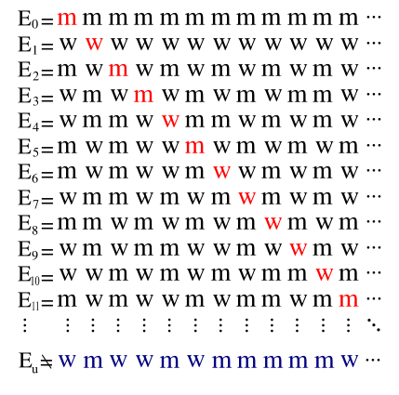
Real Numbers vs Positive Integers
Question: Is the set of real numbers countable?
Theorem: No injective mapping from real numbers to positive integers.
The string map to the first natural number
The string map to the fifth natural number
It can not be in any row i because its i-th bit is different, and so this string is not mapped!
The opposite of the diagonal

Slide 25
Diagonalization Argument
Similarly, power sets can be shown to be uncountable.
This argument is called Cantor’s diagonal argument.
http://en.wikipedia.org/wiki/Cantor's_diagonal_argument
This has been used in many places; for example the Russell’s paradox.

Slide 26
Cardinality and Computability
The set of all computer programs in a given computer language is countable.
The set of all functions is uncountable.
There must exist a non-computable function!

Slide 27
Quick Summary
Make sure you understand basic definitions of functions.
These will be used in the next lecture for counting.
The pigeonhole principle is very simple,
but there are many clever uses of it to prove non-trivial results.

